Slide 1
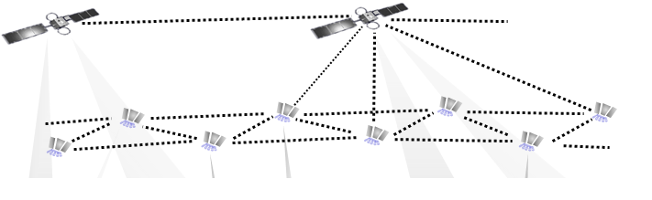
What is Satellite?
Satellite is a specialized antenna in a stable orbit above the earth.
In a satellite communications system, two or more stations on or near the earth communicate via one or more satellites that serve as relay stations in space.

Slide 2
Applications in Telecom
global telephone connections
backbone for global networks
  Reason:
    Fiber optic link has tremendous capacity
    Satellite link: signal need to travel 72000 km
    Optical link: about 10,000 km while crossing Pacific or atlantic
    Delay of 0.25 sec for Geostationary satellites
Connections for communication in remote places or underdeveloped areas
Global mobile communication
  For data service by LEO
  Tries to extend cellular network coverage, not to replace
replaced by fiber optics

Slide 3
Traditional vs. Modern Satellites
Traditional satellite were simple transponders
  Receive a signal on one frequency
  Amplify it
  Transmit it on another frequency
Today: Satellites are like Flying routers
  Many functions of higher communication layers
    Inter-satellite routing
    Error correction
Earlier only analog amplification
Now digital regeneration also
  Satellite decodes the signals into a bit-stream
  And codes it again into a signal
    Hence, higher quality of received signal on earth

Slide 4
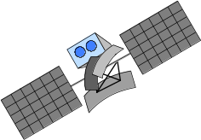

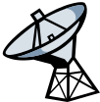


Classical satellite systems
Inter Satellite Link (ISL)
Mobile User Link (MUL)
Gateway Link (GWL)
MUL
GWL
small cells (spotbeams)
base station
or gateway
footprint
ISDN
PSTN
GSM
User data
PSTN: Public Switched
Telephone Network

Slide 5
Satellite communication
Advantages:
Area of coverage is more than that of terrestrial systems.
Each and every corner of the earth can be covered.
Transmission cost is independent of coverage area.
Higher Bandwidths are available for use.
Disadvantages:
Launching of satellites into orbits is a costly process.
Propagation delay of satellite systems is more than that of conventional terrestrial systems.
Difficult to provide repairing activities if any problem occurs in a satellite system.
Free space loss is more.

Slide 6
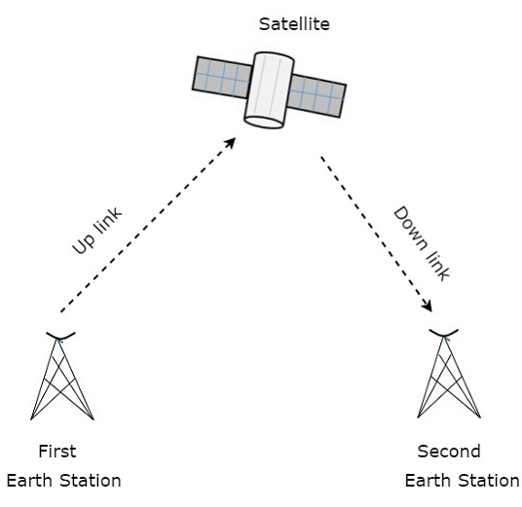
Satellite-Related Terms
The antenna systems on or near the earth are referred to as earth stations.
A transmission from an earth station to the satellite is referred to as uplink, whereas transmissions from the satellite to the earth station are downlink.
The component in the satellite that takes an uplink signal and converts it to a downlink signal is called a transponder.

Slide 7
Satellite-Related Terms
Inclination angle is defined as the angle between the equatorial plane and the plane described by the satellite orbit.
  -- An inclination angle of 0 degrees means that the satellite is exactly above the equator.
Elevation angle is defined as the angle between the center of the satellite beam and the plane tangential to the earth’s surface.
Footprint can be defined as the area on earth where the signals of the satellite can be received.

Slide 8

Satellite Periods
The time required for a satellite to make a complete trip around the Earth, is determined by Kepler's law,
    which defines the period as a function of the distance of the satellite from the center of the Earth.
Here C is a constant approximately equal to 1/100. The period is in seconds and the distance in kilometers.

Slide 9
Example-1
What is the period of the Moon, according to Kepler’s law?
Solution
The Moon is located approximately 384,000 km above the Earth. The radius of the Earth is 6378 km. Applying the formula, we get.

Slide 10
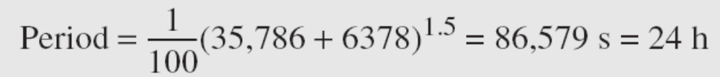
Example-2
According to Kepler’s law, what is the period of a satellite that is located at an orbit approximately 35,786 km above the Earth?
Solution
Applying the formula, we get

Slide 11
Example-2 (continued)
This means that a satellite located at 35,786 km has a period of 24 h, which is the same as the rotation period of the Earth. A satellite like this is said to be stationary to the Earth. The orbit, as we will see, is called a geosynchronous orbit.

Slide 12
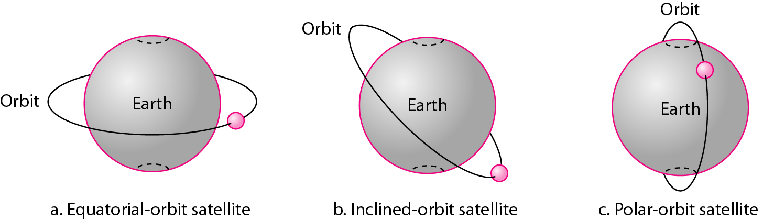
Satellite orbits
An artificial satellite needs to have an orbit, the path in which it travels around the Earth.
The orbit can be
  Equatorial- orbit above earth’s equator
  Polar- orbit passes over both poles
  Inclined- Other orbits referred to as inclined orbits

Slide 13
Basics
Satellites in circular orbits
  attractive force of the earth due to gravity
  F_{g} = m g (R/r)²
  Centrifugal force, F_{c} = m r ω²
  m: mass of the satellite
  R: radius of the earth (R = 6370 km)
  r: distance of the satellite to the center of earth
  g: acceleration of gravity (g = 9.81 m/s²)
  ω: angular velocity, ω = 2 π f
    f: rotation frequency

Slide 14
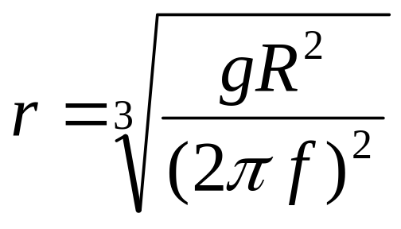
Basics
To keep satellite stable in circular orbit
  F_{g} = F_{c}
  F_{g} = m g (R/r)²
  F_{c} = m r ω²
  m g (R/r)² = m r ω²
The distance r of the satellite to the center of the earth results in the following equation:
Notes:
the period of 24 hours f = 1/24h, the resulting distance is
35,786 km. The orbit must have an inclination of 0 degrees.

Slide 15
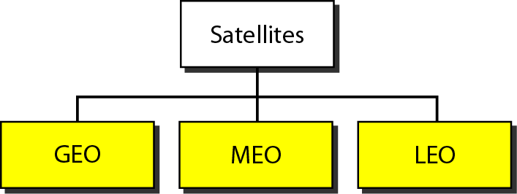
Satellite categories
Based on the location of the orbit, satellites can be divided into three categories: geostationary Earth orbit (GEO), low-Earth-orbit (LEO), and middle-Earth-orbit (MEO)

Slide 16
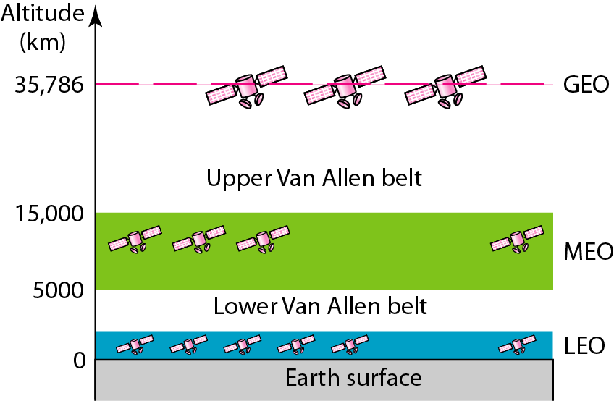
Satellite orbit altitudes
Notes:
Figure shows the satellite altitudes with respect to the surface of the Earth. There is only one orbit, at an altitude of 35,786 km for the GEO satellite. MEO satellites
are located at altitudes between 5000 and 15,000 km. LEO satellites are normally below an altitude of 2000 km. One reason for having different orbits is due to the existence of two Van Allen belts. A Van Allen belt is a layer that contains charged particles.

Slide 17
Geostationary satellites
Orbit 35,786 km distance from earth surface, orbit in equatorial plane (inclination 0°)
complete rotation exactly one day, satellite is synchronous to earth rotation
fix antenna positions, no adjusting necessary
A large footprint (up to 34% of earth surface!), therefore difficult to reuse frequencies
Three satellites can cover the whole globe
HIGH transmit power needed
high latency due to long distance (275 ms)
Not useful for global coverage for small mobile phones and data transmission, typically used for radio and TV transmission

Slide 18
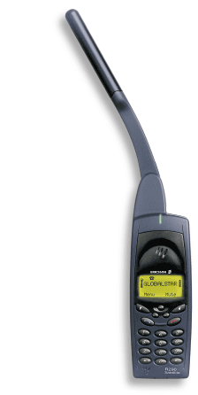

LEO systems
Orbit 500 - 1500 km above earth surface
visibility of a satellite 95 - 120 minutes
global radio coverage possible
latency comparable with terrestrial long distance
connections, 5 - 10 ms
smaller footprints, better frequency reuse
but now HANDOVER necessary from one satellite to another
many satellites necessary for global coverage
more complex systems due to moving satellites
Examples:
  Iridium (start 1998, 66 satellites)
  Globalstar (start 1999, 48 satellites)

Slide 19
MEO systems
Orbit approx. 5000 - 12000 km above earth surface
Comparison with LEO systems:
  slower moving satellites
  less satellites needed
  simpler system design
  for many connections no hand-over needed
  higher latency, about 70 - 80 ms
  higher sending power needed
  special antennas for small footprints needed
Example:
  GPS: period 12 hrs

Slide 20
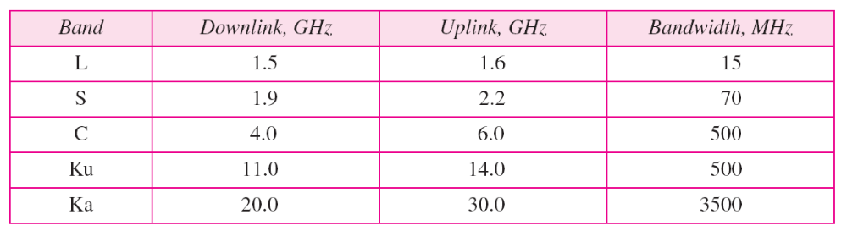
Table-1: Satellite frequency bands

